Slide 1
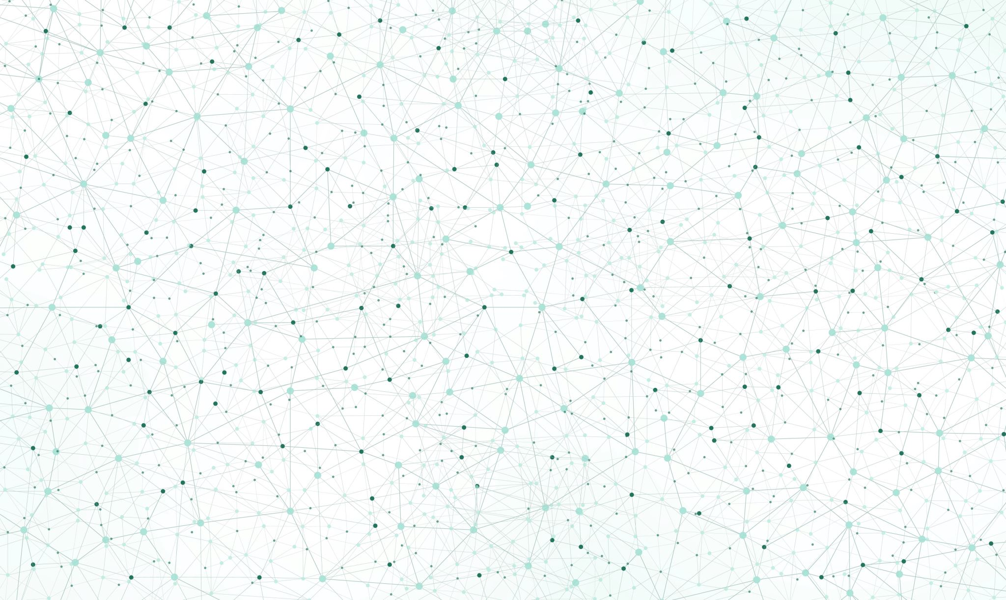
QCML Course Lab Session – 06
By Aniket,
Indian Institute of Technology Delhi

Slide 2
What we have done so far…
Installation and Introduction to Qiskit
Introduction to Quantum Circuits
BB84 Protocol & Quantum Teleportation
Introduction to Quantum Algorithms
Deustch-Jozsa Algorithm

Slide 3
What we will do today…
Back to Basics
Clearing as many of our doubts as possible.

Slide 4
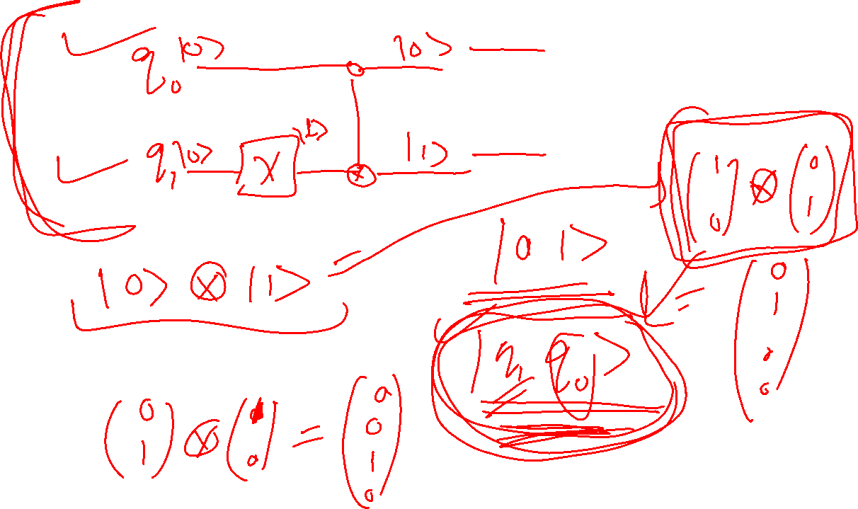

Slide 5
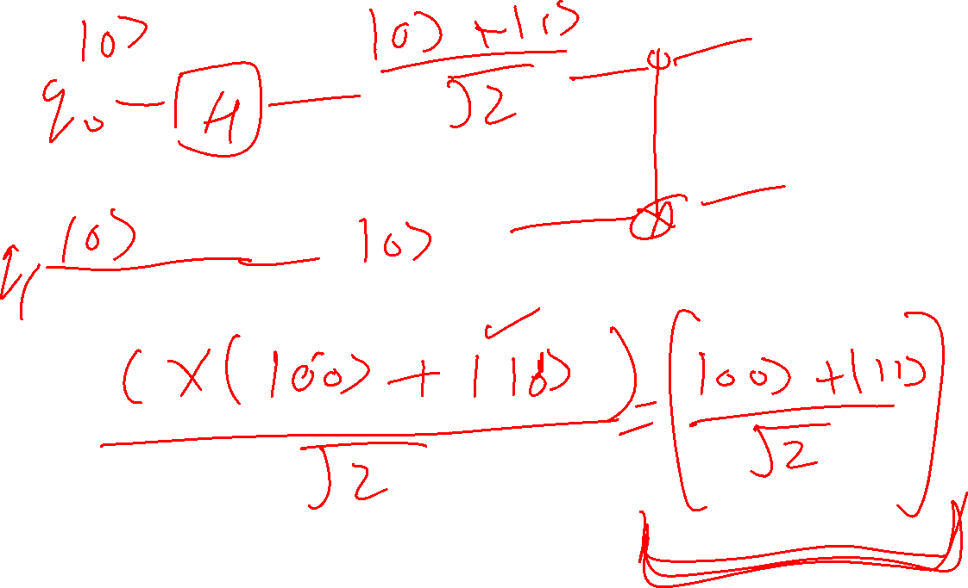

Slide 6
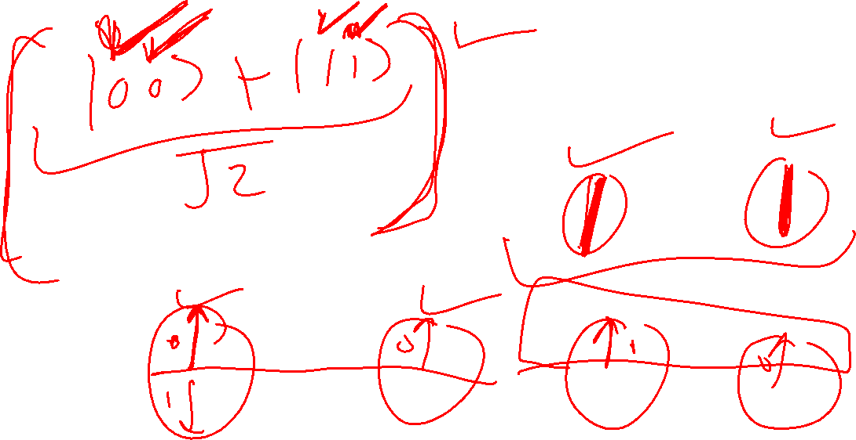

Slide 7
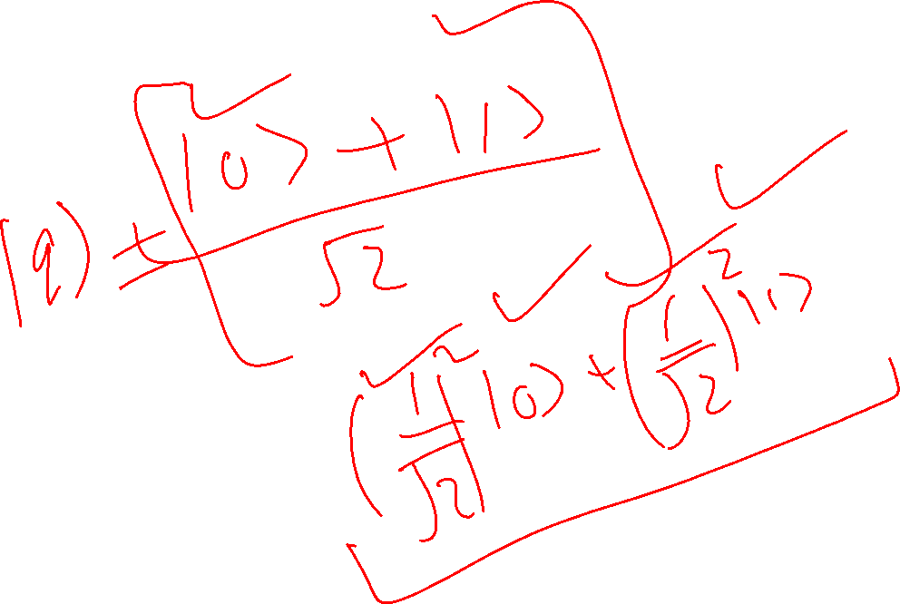

Slide 8
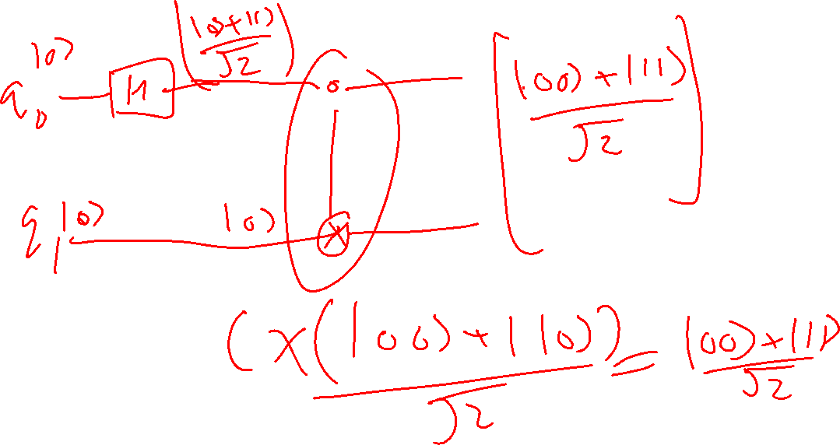

Slide 9
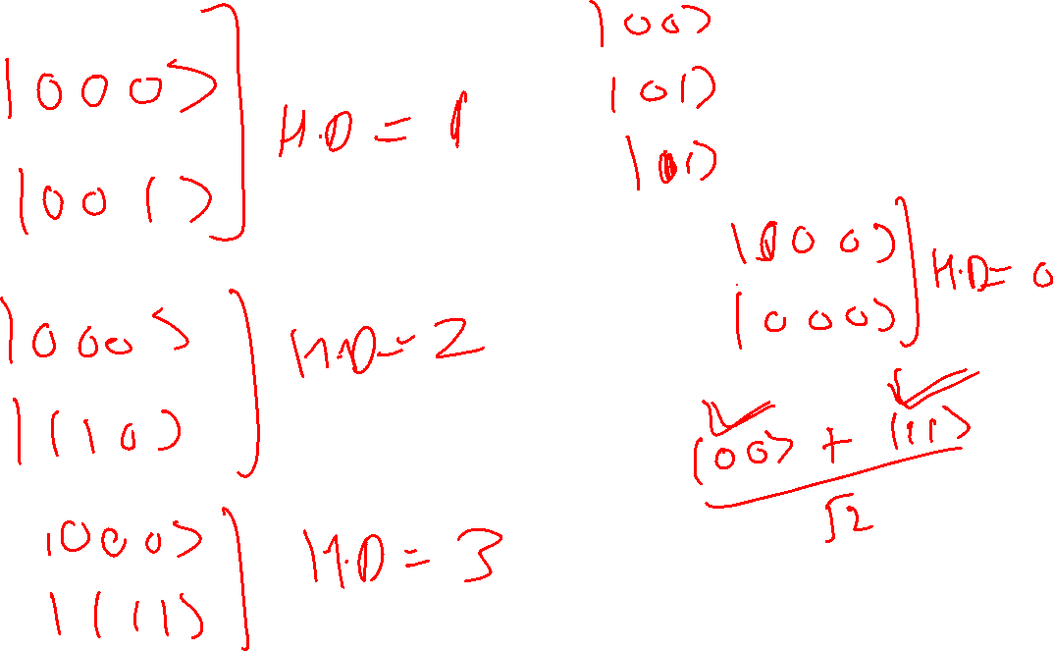

Slide 10
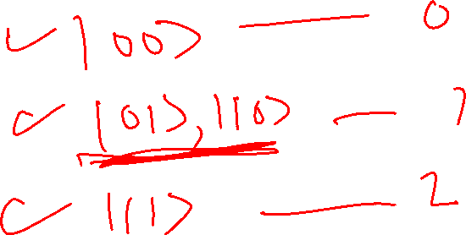
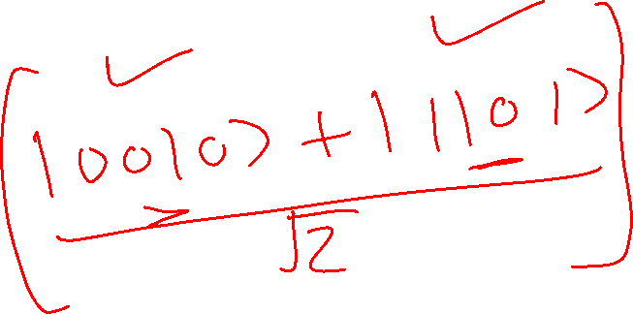

Slide 11
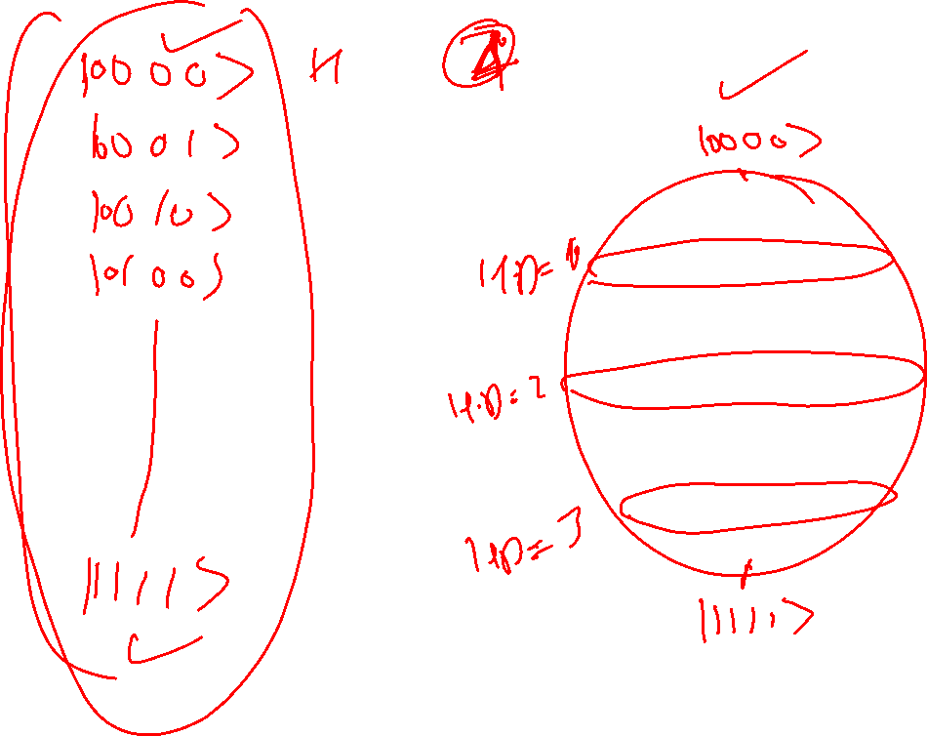

Slide 12
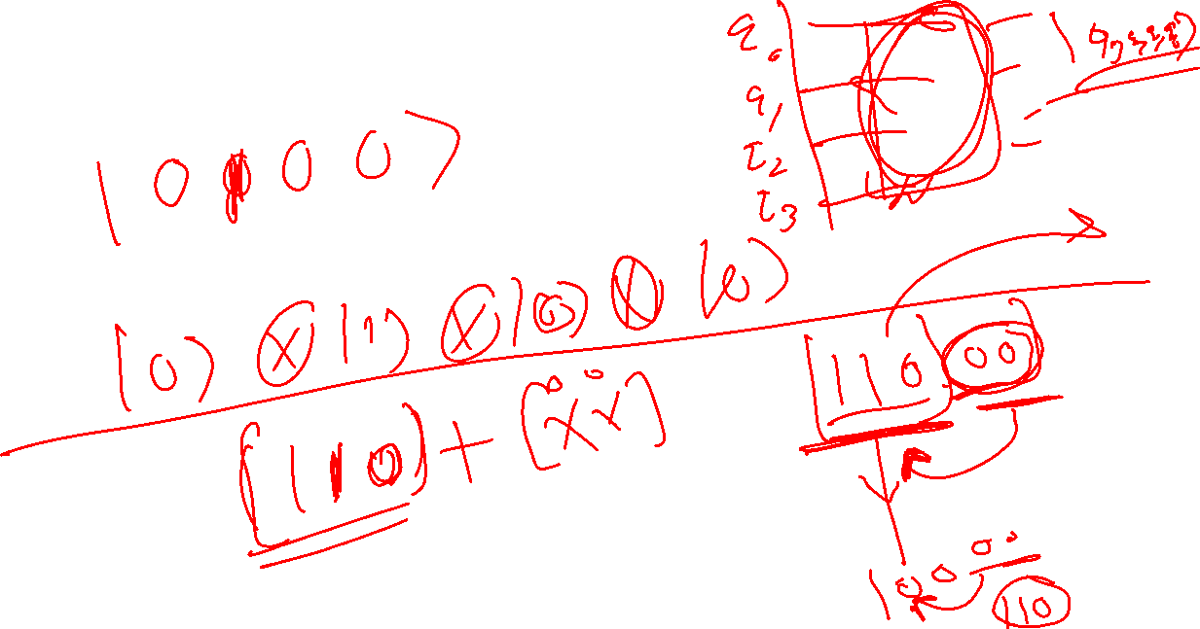

Slide 13
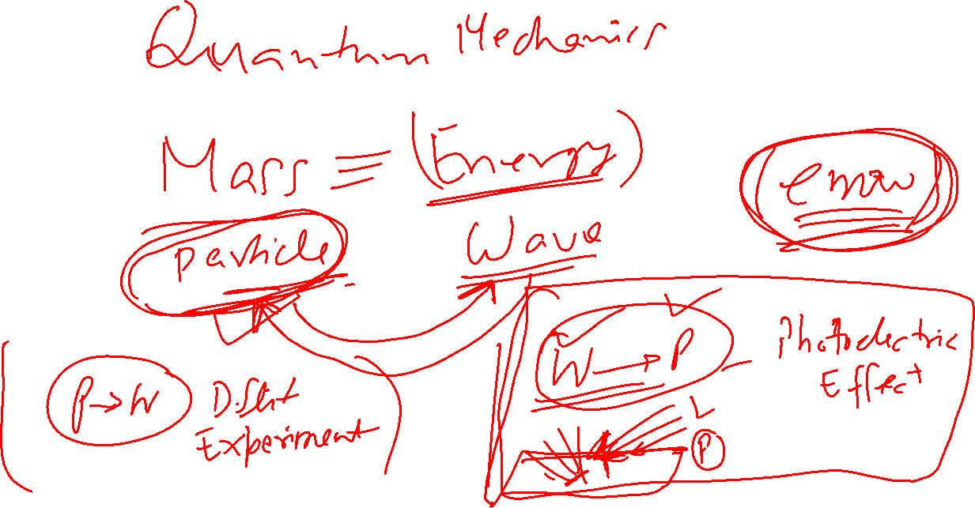

Slide 14
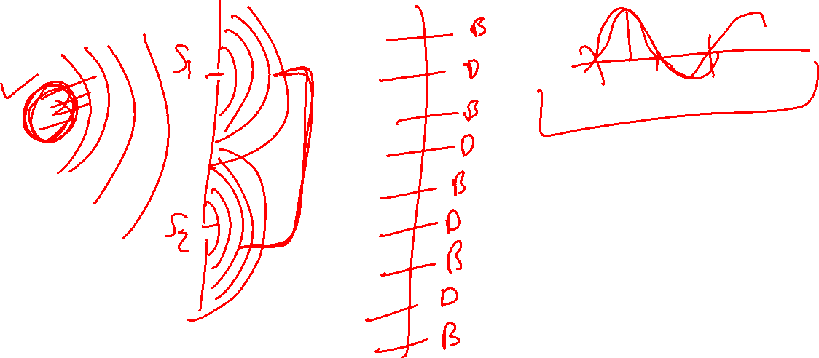
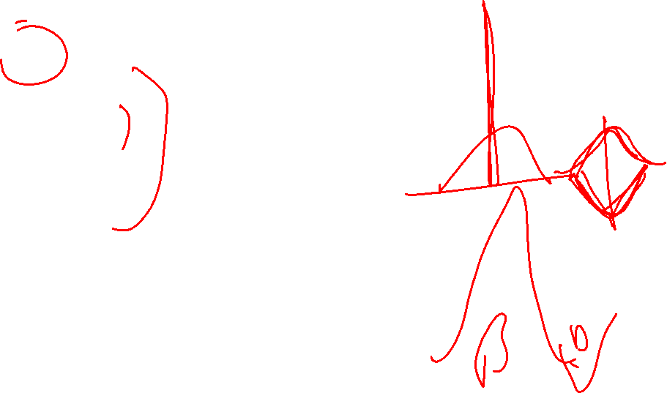

Slide 15

